Slide 1
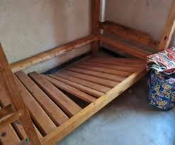
Reported Speech
Buying a bed

Slide 2
Single bed for sale
“I’m selling this bed in good condition for £120. The mattress is clean and lightly used. Buyer can collect it or request local delivery. Delivery will take 2–3 days. Payment by cash or card on collection or delivery. Return if not satisfied."
Last week you bought a bed. It was delivered in a terrible condition 5 days after you ordered it, and the driver wouldn’t take your card. You had to borrow cash from your roommate. Now they will not let you return it.
Task: Write an email to your friend explaining what the advert said and why you are angry.

Slide 3
Hi ________
You’ll never guess what happened! Last week I finally decided to buy a new bed. I couldn’t afford a new one, so I went online. I found one which I thought was great but …….
Reporting verbs:
Said
Claimed
Mentioned
Described
Stated
Denied
Write two paragraphs.
What happened
What do you want to do now

